Slide 1
Maths Daily Practice
Grade 1 - Week 7
Complete this work in a notebook at home. This is not mandatory homework.
Therefore, it does not need bringing into school. This is optional practice to support the learning taking place in school.

Slide 2
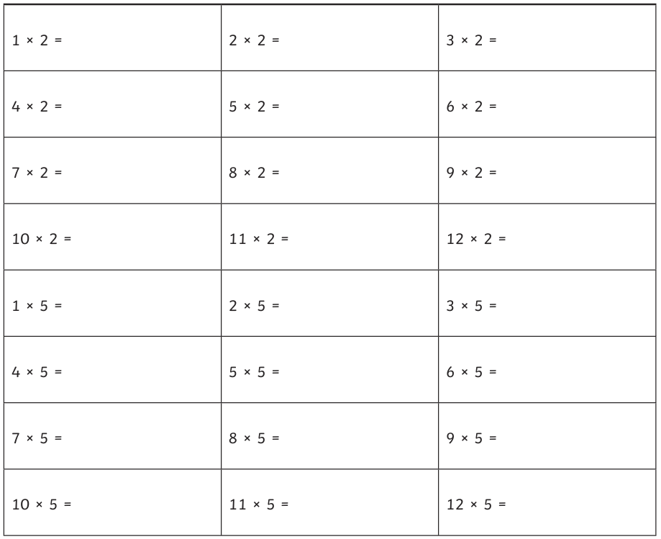
Daily practice 1
Multiplication

Slide 3
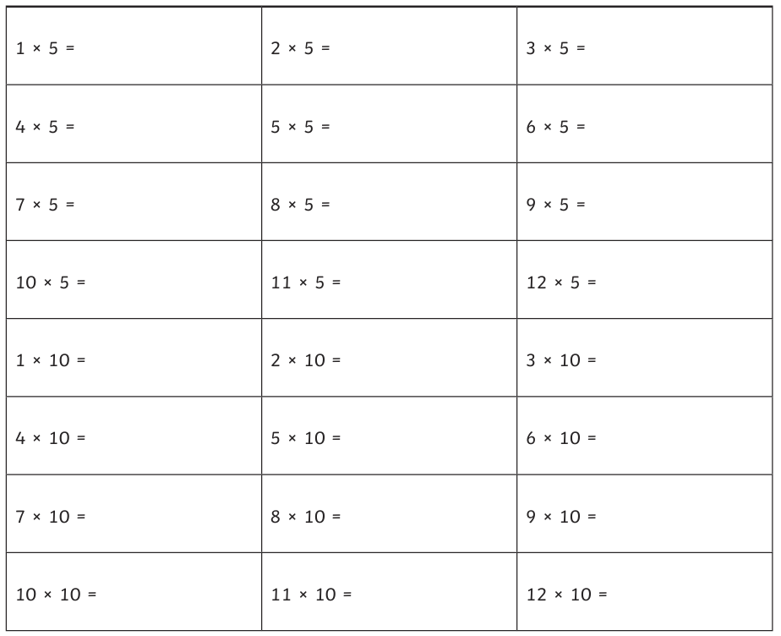
Daily practice 2
Multiplication

Slide 4
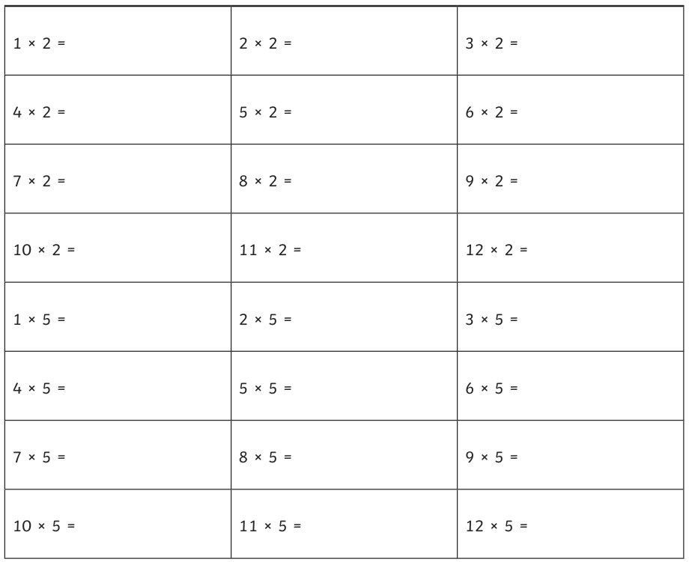
Daily practice 3
Multiplication

Slide 5
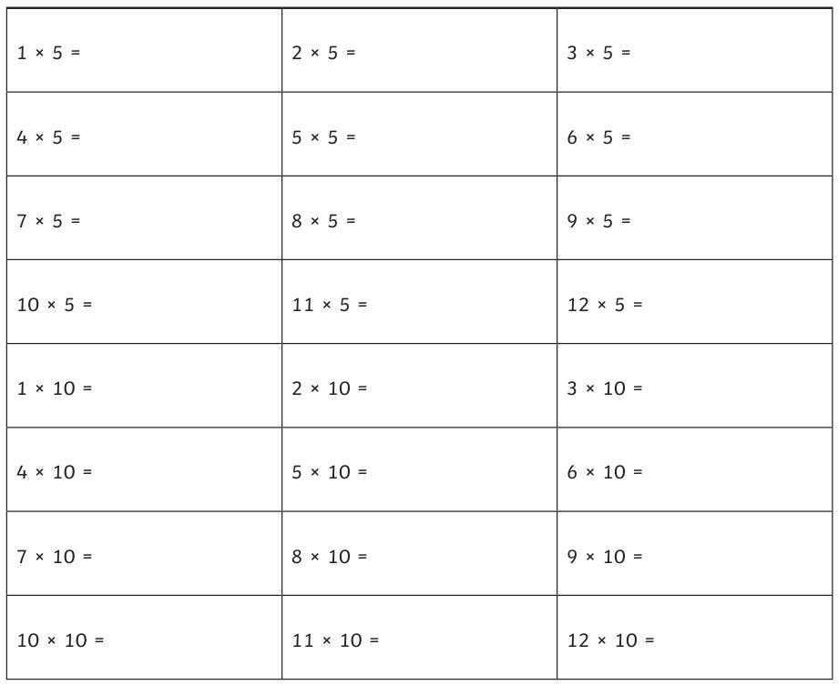
Daily practice 4
Multiplication

Slide 6
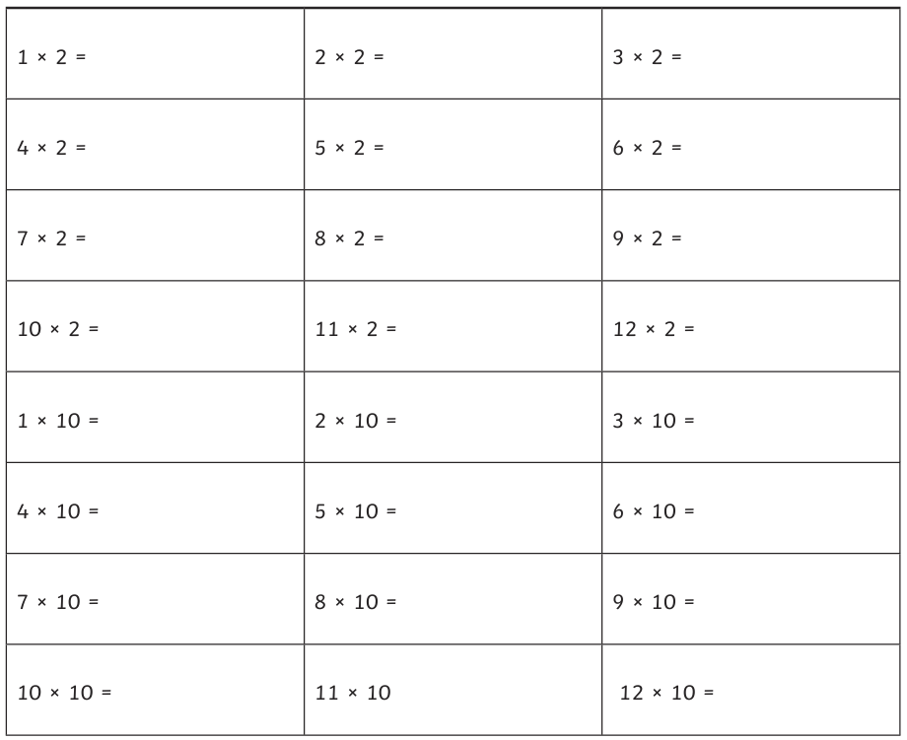
Daily practice 5
Multiplication

